Slide 1



Attention-Based Models for HTTP Payload Anomaly Detection
Cybersecurity threats are evolving rapidly. Advanced anomaly detection is crucial. This presentation focuses on analyzing HTTP payloads using attention mechanisms.
Presented by :-
Shrushty Dhamange -202201070016
Shivshankar Ghyar -202201040031
Tejas Gophane -202201040063
Guided by :-
Dr. Diptee Ghusse
Github link :-
https://github.com/shiv-1540/DL-FInal-Practical.git
Notes:
1

Slide 2






Introduction: The Growing Threat Landscape
Sophisticated Cyberattacks
Primary Attack Vector
Web applications increasingly targeted by complex attacks.
HTTP payloads play a critical role in delivering attacks.
Attack Increase
Example Case
Significant rise in HTTP-based attacks in 2023.
High-profile breach through payload injection.
Traditional Methods Limitations
Signature-based detection struggles with new threats.
Notes:
2

Slide 3

Objective: Enhancing Anomaly Detection
Develop Deep Model
Build attention-based model for HTTP payloads.
Improve Accuracy
Detect malicious payloads more precisely than traditional methods.
Reduce False Alarms
Minimize false positives, easing alert overload.
Real-Time Threat Response
Enable fast, actionable intelligence for security teams.
Notes:
3

Slide 4
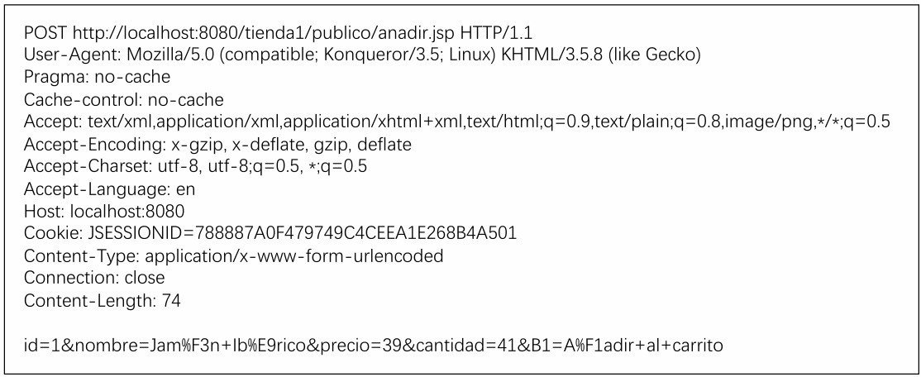
Problem Statement: Challenges in HTTP Payload Analysis
Payload Complexity
HTTP payloads vary widely in structure and content.
Evasion tactics like obfuscation and polymorphism complicate detection.
Feature Engineering Limits
Manual features miss subtle and evolving anomalies.
High data volume challenges scalability of traditional methods.
Dynamic web traffic demands adaptive models.
Notes:
4

Slide 5

Dataset Overview: KDDCUP’99
This dataset comprises HTTP request payloads labeled as either benign or anomalous. It's structured to facilitate the training and evaluation of models for detecting anomalies in HTTP traffic.
Key Features:
Data Format: CSV files containing HTTP request payloads.
Labels: Each entry is labeled as 'normal' or 'anomalous'.
Anomalous Categories: Includes various attack types such as SQL injection, Cross-Site Scripting (XSS), and buffer overflow attacks.
Dataset link :https://www.kaggle.com/datasets/anushonkar/network-anamoly-detection
Usage: Ideal for training and testing machine learning models focused on HTTP payload anomaly detection.
Notes:
5

Slide 6

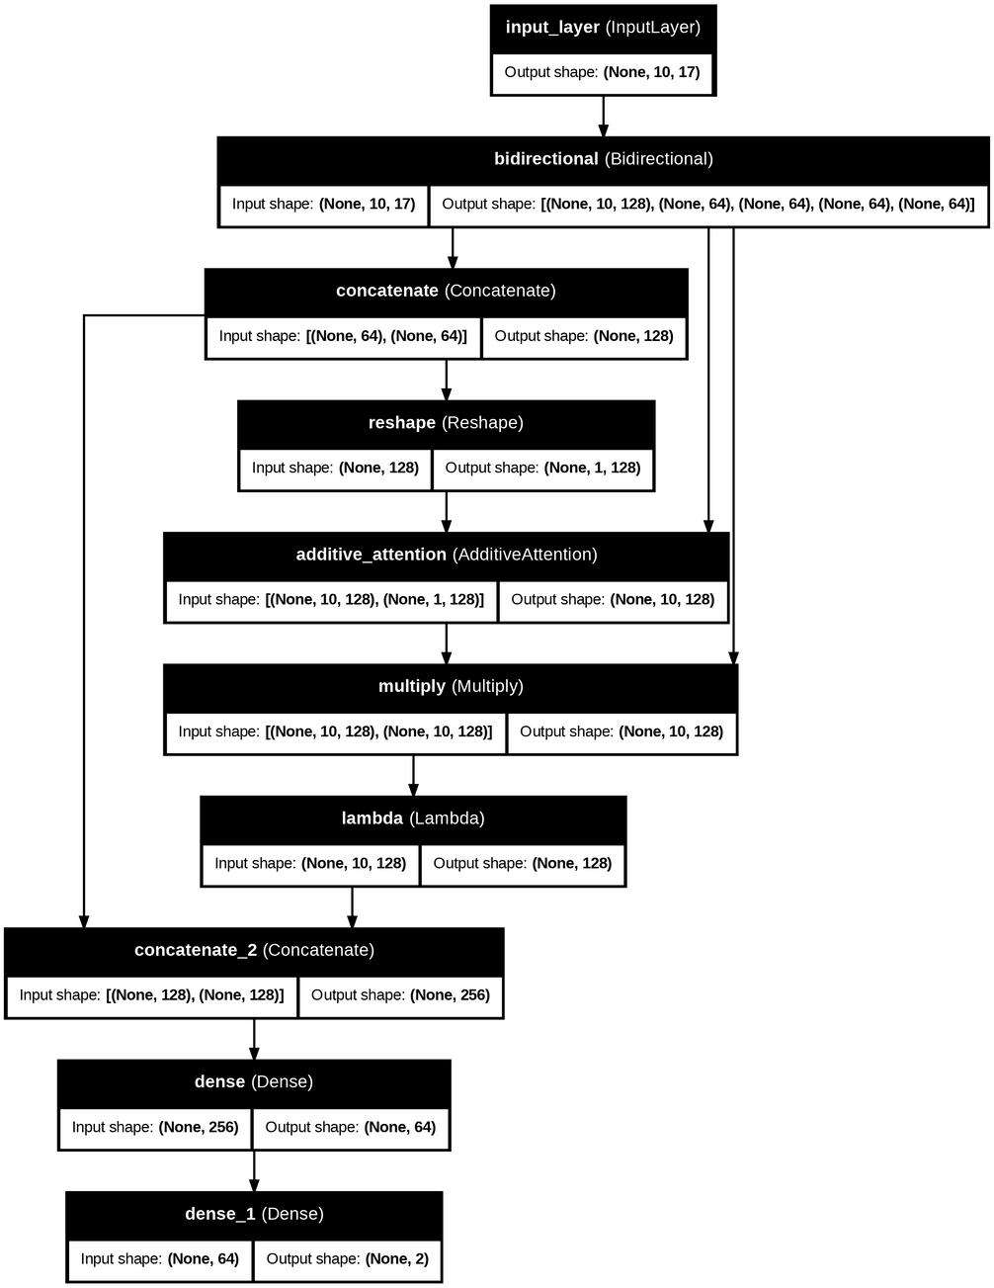



Methodology: Attention-Based Model Architecture
Data Collection
Use real HTTP traffic datasets like KDDCUP’99 .
Preprocessing
Tokenize and embed payloads with 300-dimensional word2vec/GloVe.
Model Architecture
LSTM/GRU layers capture sequence; attention focuses on key parts.
Training & Evaluation
Supervised learning with labeled data, track precision, recall, F1-score.
Notes:
6

Slide 7
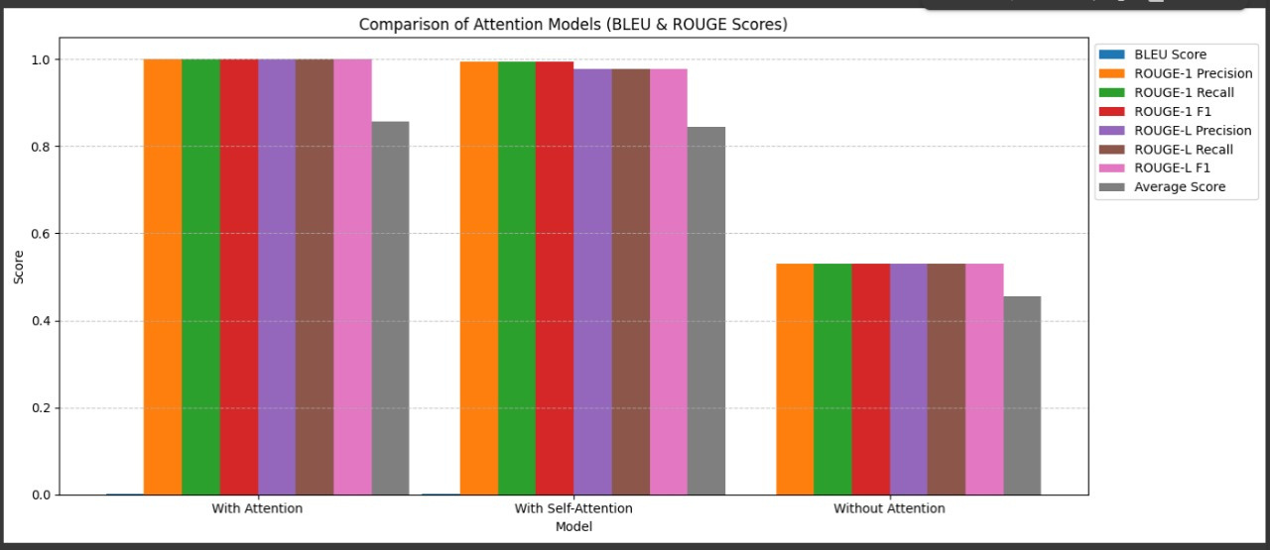
Results: Performance Evaluation and Comparison
1
Benchmarking
3
Interpretability
Outperforms signature-based intrusion detection systems.
Attention weights provide insights into model decisions.
2
Improved Metrics
4
Use Case
Higher precision and recall; significant F1-score gains.
Accurate detection of SQL injections in HTTP POST requests.
Notes:
7

Slide 8

Conclusion: Advantages of Attention-Based Approach
Improved Accuracy
Attention mechanisms boost anomaly detection.
Adaptability
Models adjust to changing threat patterns.
Reduced Manual Work
Less reliance on handcrafted features.
Faster Response
Enables real-time threat intelligence.
Notes:
8

Slide 9
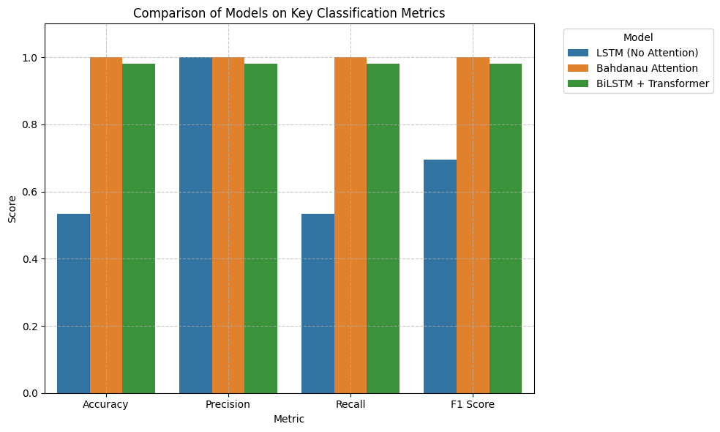
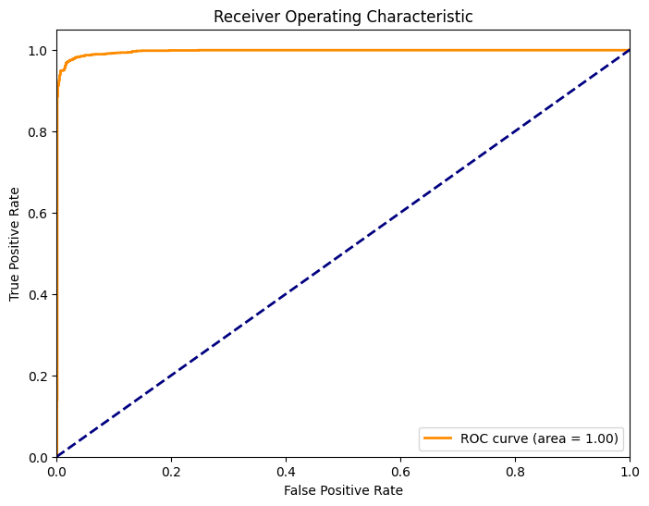
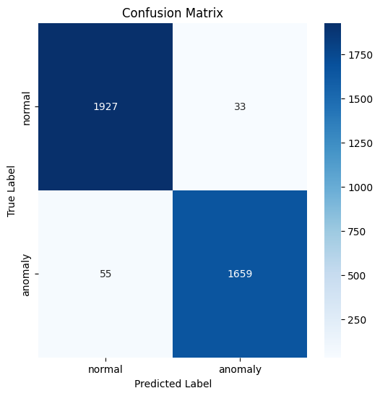
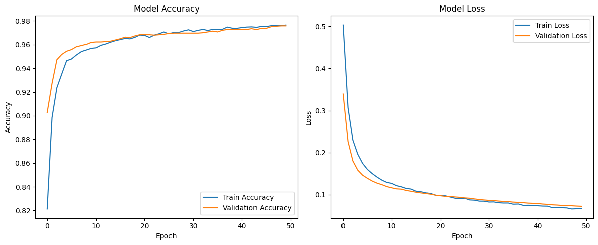
Notes:
9

Slide 10





Future Scope: Expanding the Horizon
User Behavior
Incorporate contextual analytics.
Unsupervised Learning
Explore anomaly detection without labeled data.
Adversarial Training
Enhance robustness against attacks.
WAF Deployment
Integrate model into real web firewalls.
Transfer Learning
Leverage knowledge from other cybersecurity domains.
Notes:
9

